Slide 1
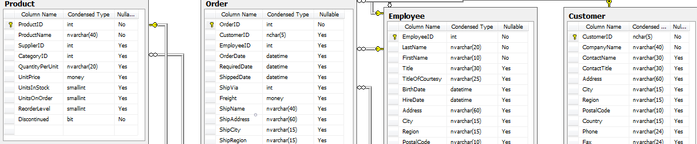

Northwind DB Hypothesis Testing

Slide 2

Hi there! I’m a software engineer based in NY and working for the UN, and an aspiring data scientist at Flatiron Academy
Barto Molina, Flatiron DS, April 2019 cohort

Slide 3
the project
77 products from 29 suppliers
8 categories
830 orders shipped by 3 shipping companies
9 employees covering 53 territories in 4 regions
91 customers from all over the world

Slide 4
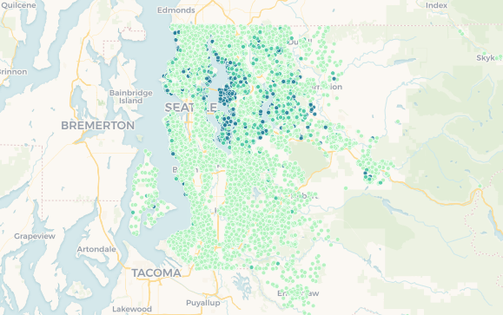
waterfront
latitude
waterfront houses 75% more expensive
moving 32 miles north increases price 1.5%
Discount

Slide 5
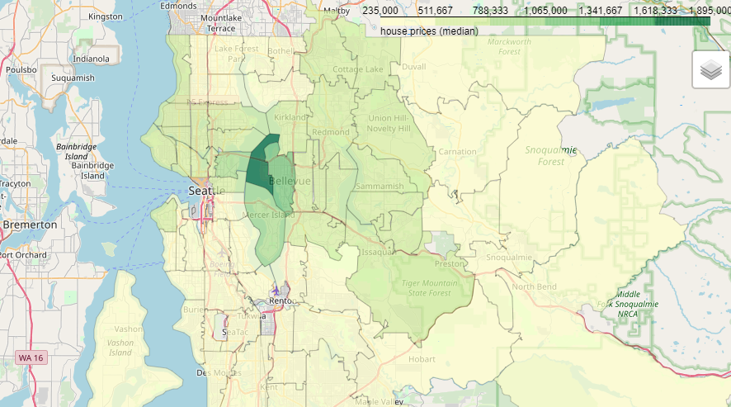
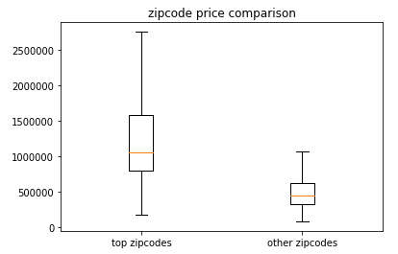
top
zipcodes
54% price increase
Bellevue
Medina
Clyde Hill
Mercer Island
East Seattle
location

Slide 6
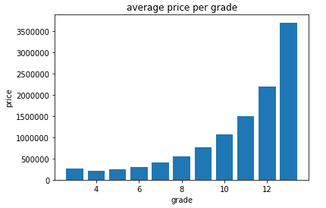
grade
condition
condition
Grade can increase price up to 180%
1. Falls short of minimum building standards. Normally cabin or inferior structure.
...
13. Generally custom designed and built. Mansion level. Large amount of highest quality cabinet work, wood trim, marble, entry ways etc.
Condition 1 - 3 to 4/5 can increase price up to 12%

Slide 7
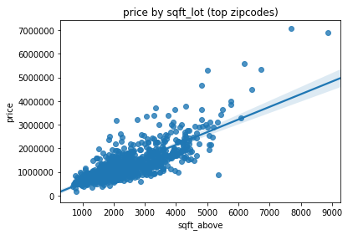
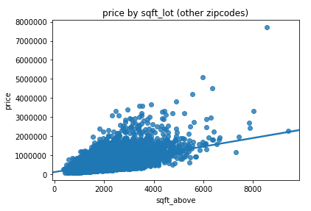
square
footage
1,000 sqft to 1,100 sqft:
15% price increase
features
However…
look at the living square footage!

Slide 8
final recommendations
waterfront – 75% up
top 4 zipcodes – 50% up
grade instead of condition – up to a 180%
living area instead of total square footage

Slide 9
thank you.

